Slide 1
The Plasmaspheric Plume!
Kenton E. Miller
Mentors: Dr. Brian Walsh and Dr. David Sibeck

Slide 2
The Plasmasphere
Def: the region of dense, cold plasma around the Earth
Convection
Caused by southward solar wind and reconnection
Geomagnetic storm
Disturbances of Earth’s magnetosphere due to strong solar wind

Slide 3
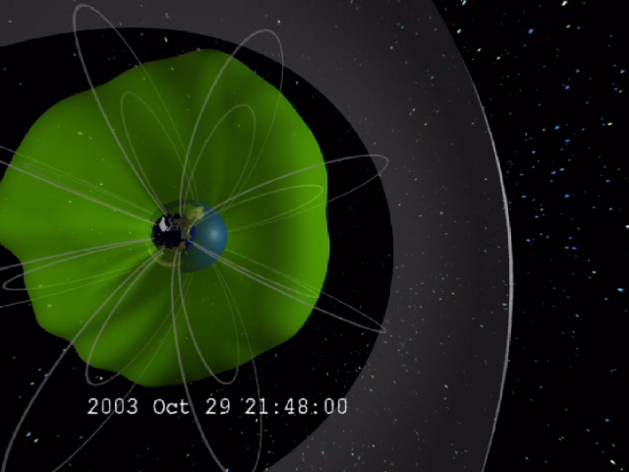

Slide 4
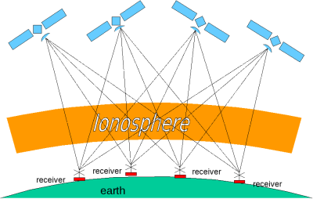
Data
TEC (Total Electron Content)
A measurement of the density of electrons along a line of sight

Slide 5
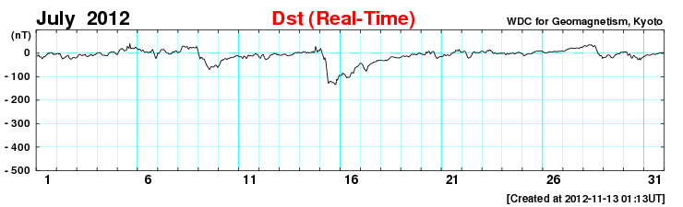
Data
DST Index
Disturbed STorm Index

Slide 6
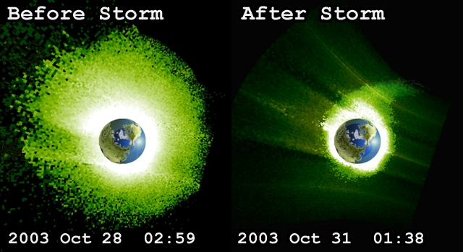
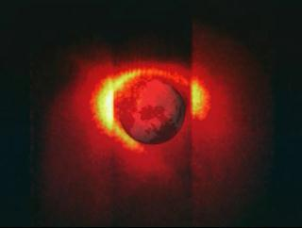
How can we study the plume with TEC?
IMAGE
Previous NASA mission
Plasma and magnetic field lines
Plasma follows field lines

Slide 7
Tools
TECmaps
Creates a plot of the TEC on a map of the Earth
FieldLineTracer
Traces and plots the magnetic field lines of Earth using T96 model
SpaceTEC and SpaceTECMods
Functions and implementation to create a plot of the TEC in the equatorial plane

Slide 8
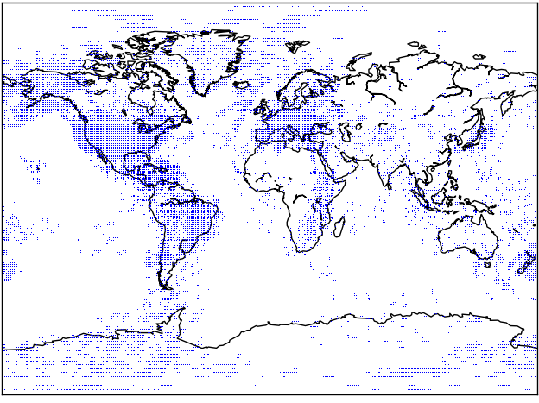
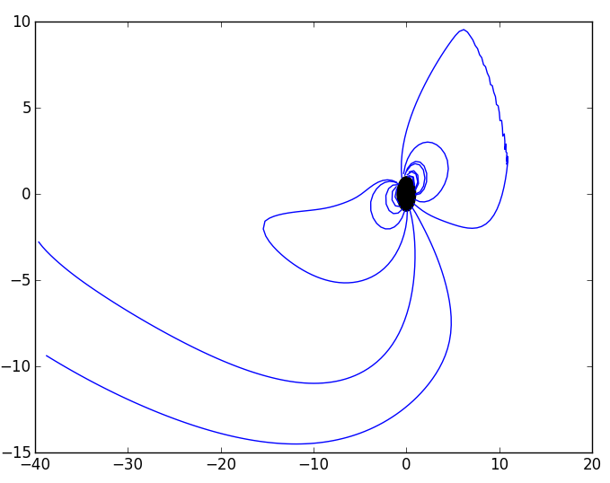
Magnetic field lines (T96 model)
Ground based GPS receiver coverage (per 10 minutes)

Slide 9
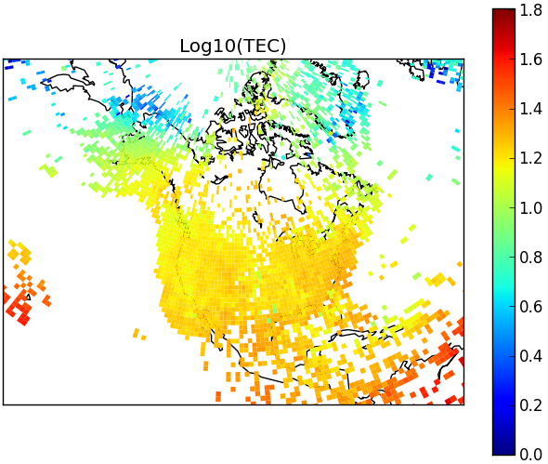
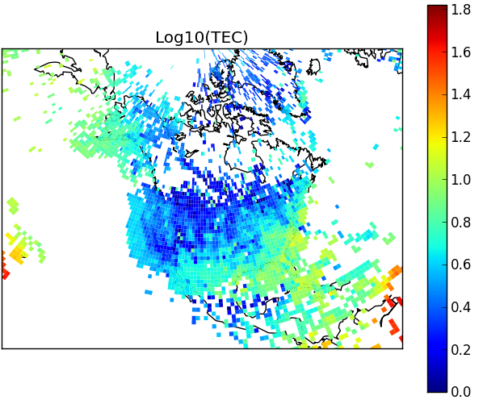
TECmaps

Slide 10
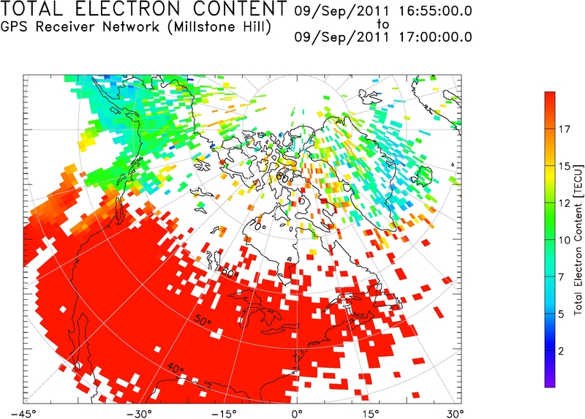
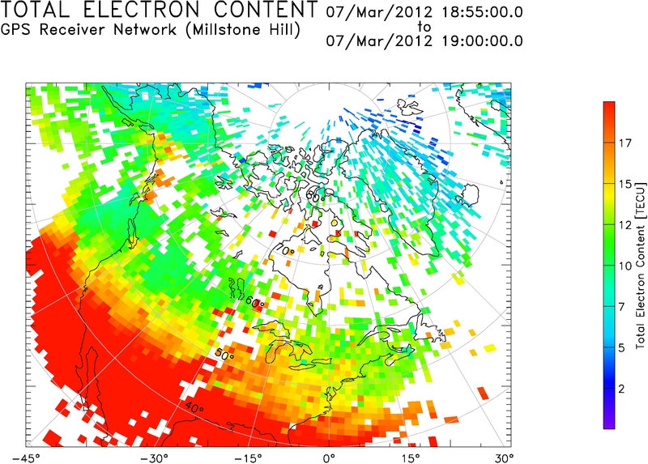

Slide 11
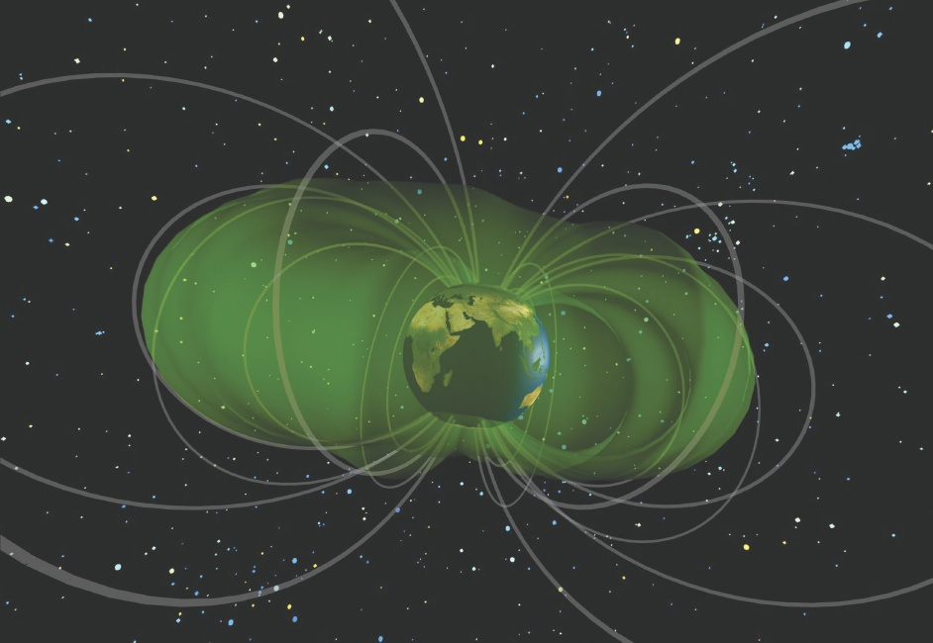

Slide 12
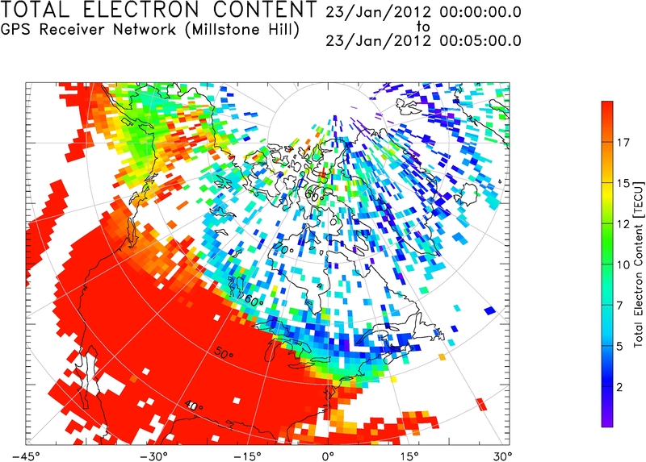
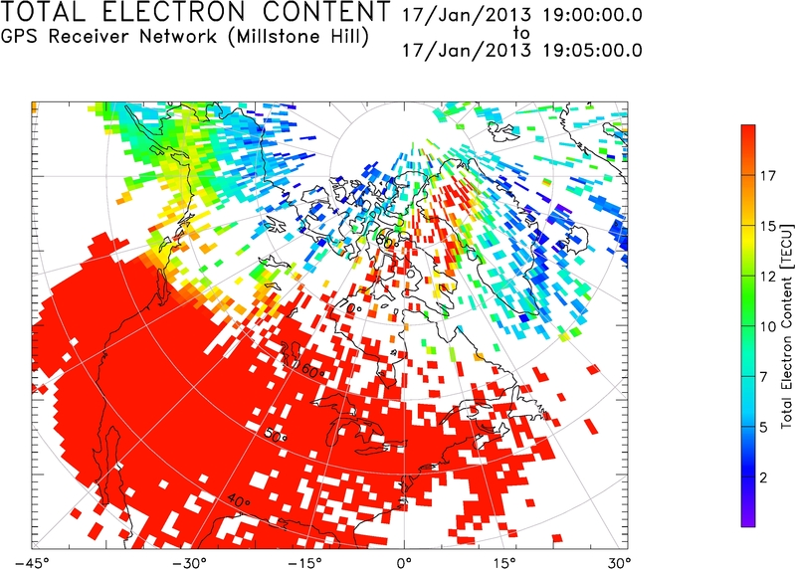

Slide 13
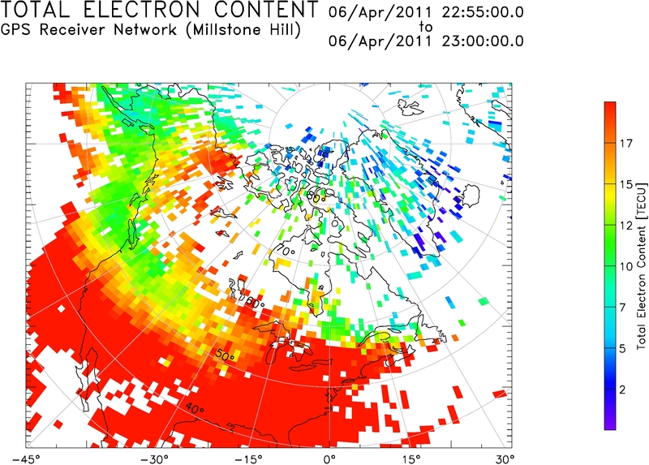
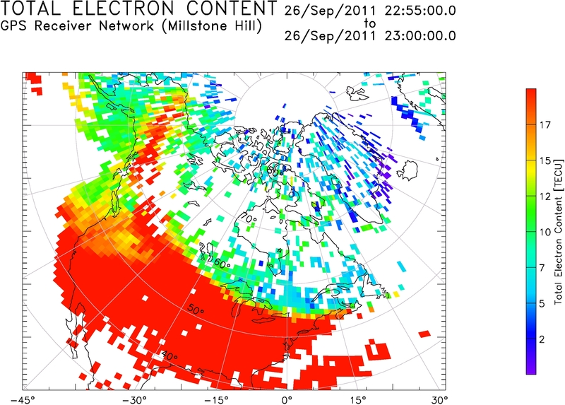

Slide 14
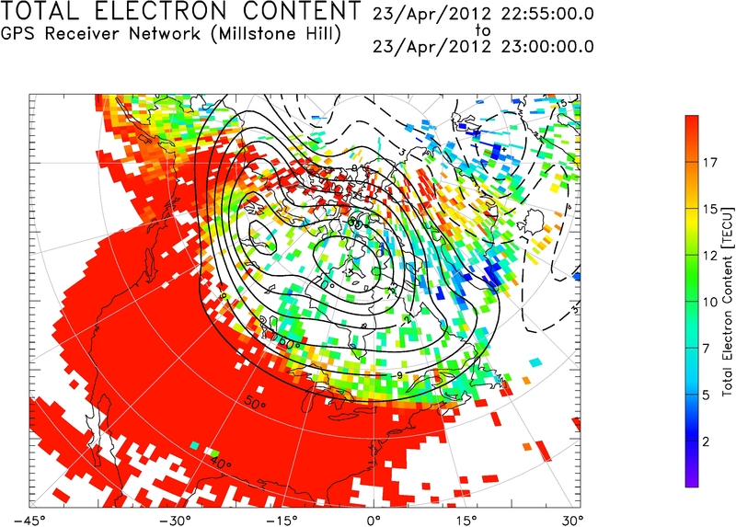

Slide 15
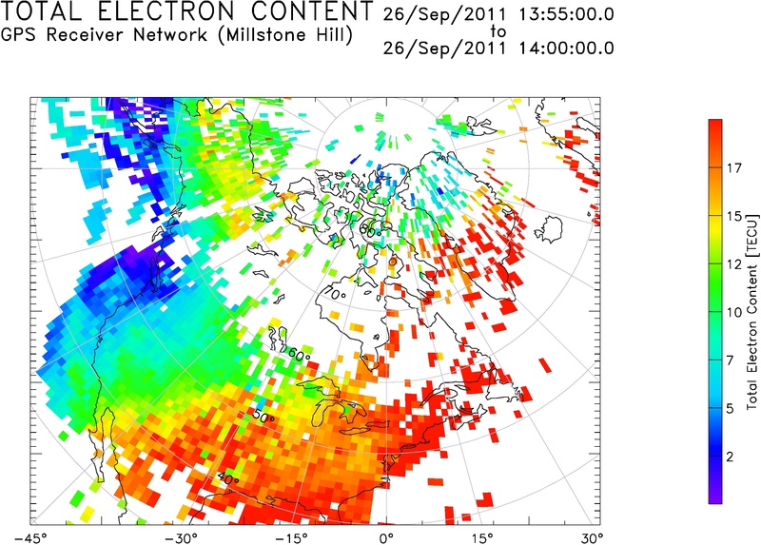
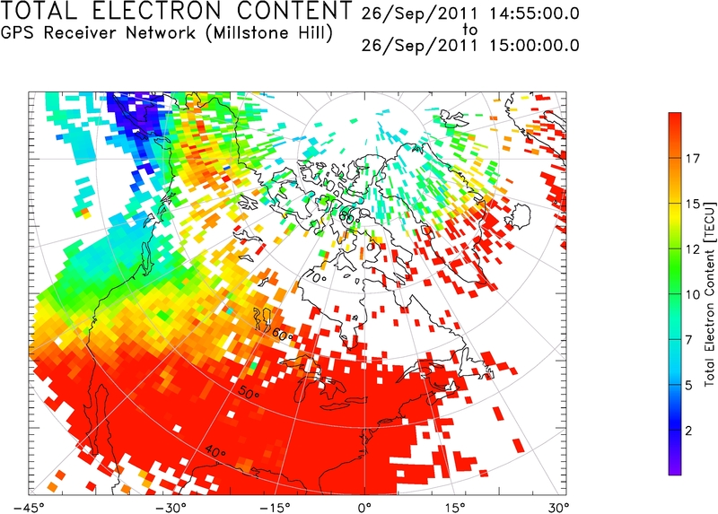
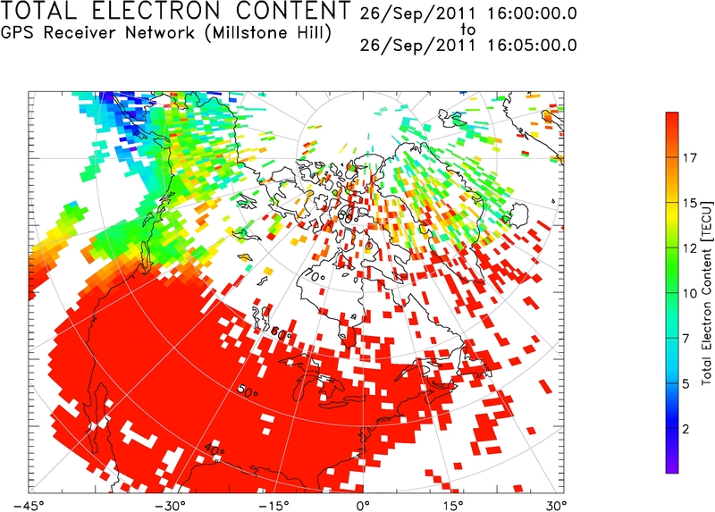
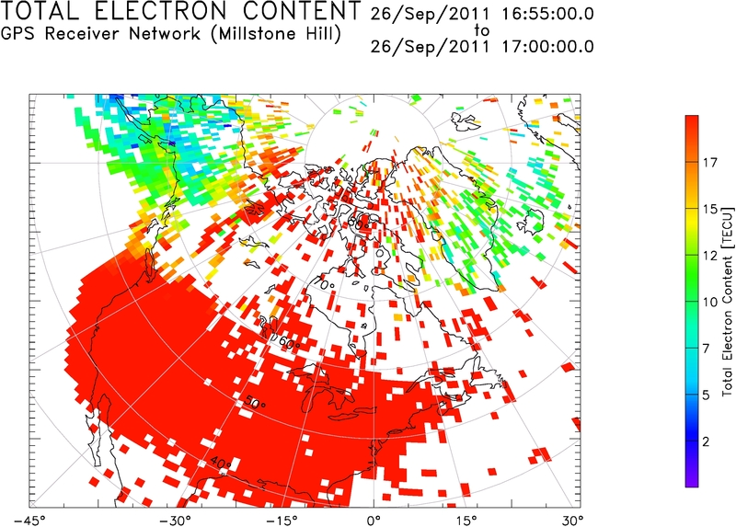
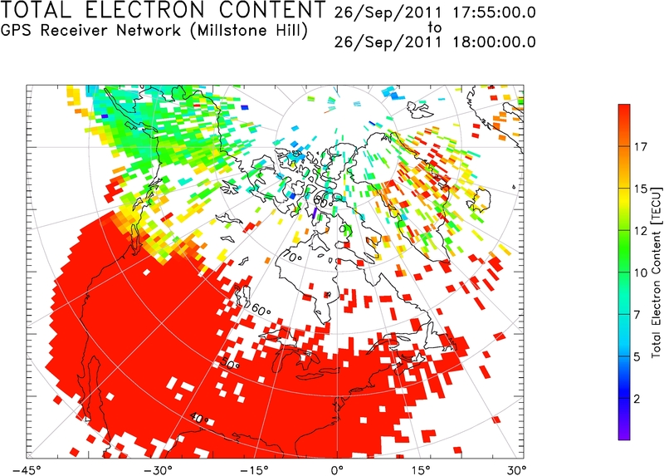
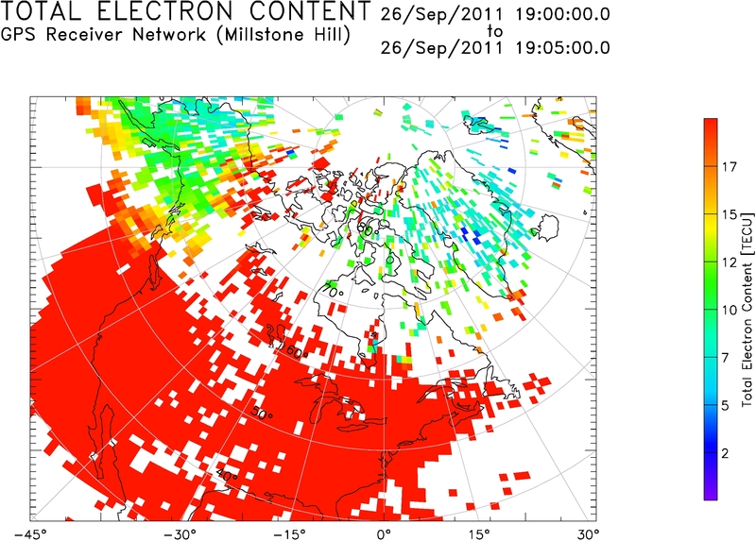
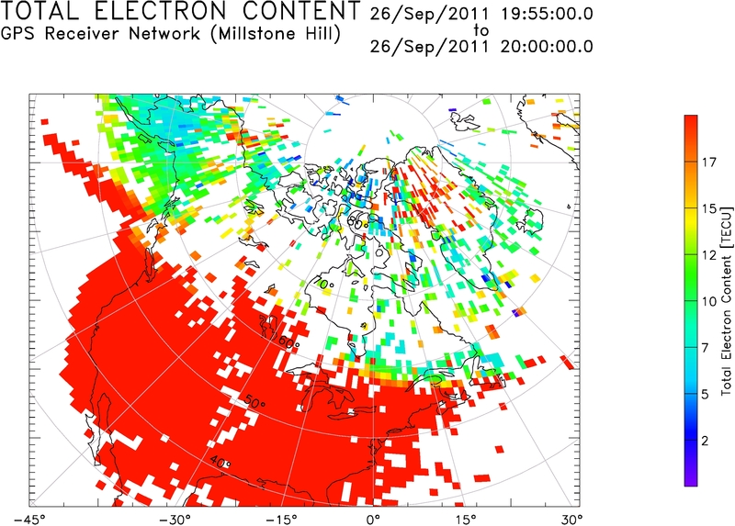
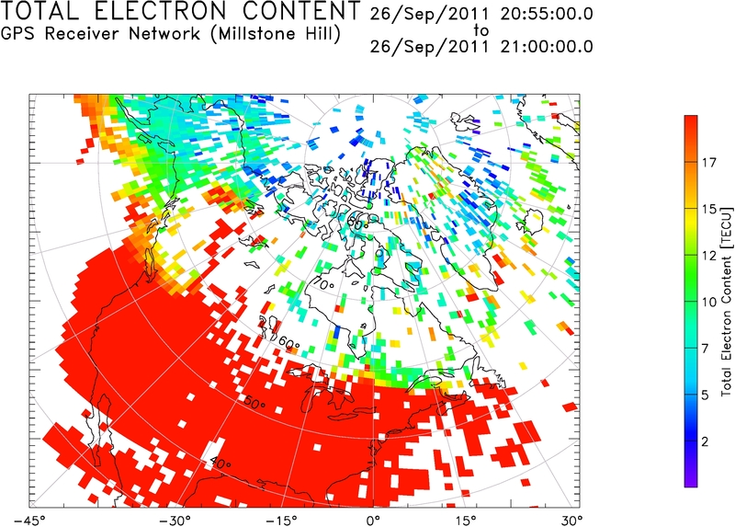
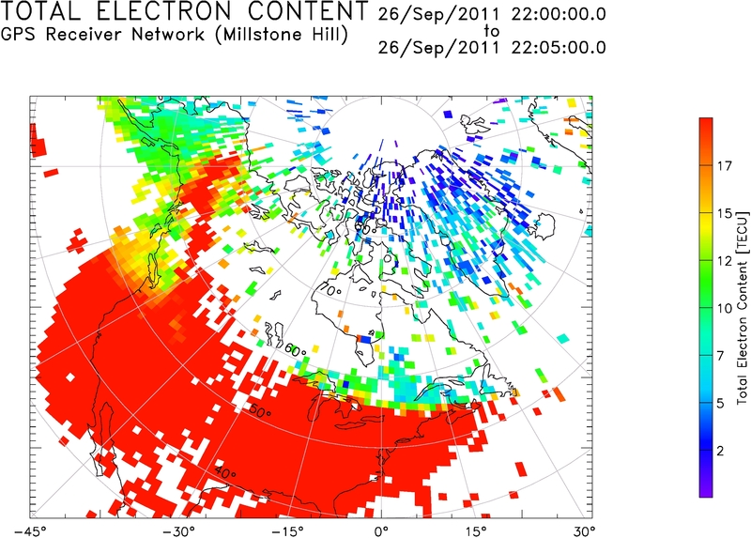

Slide 16
Stats
Total years catalogued = 3 2013, 2012, 2011
Total days w/ DST ≤ -50 = 64
Total days w/ plume = 27
≅ 42 %
Conclusion: TEC measurements are a good way to determine plume occurrence

